Slide 1
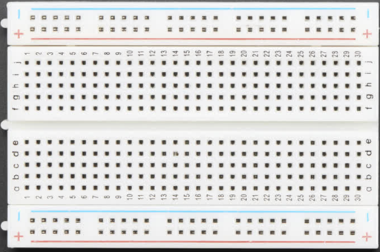
Breadboard Layout
Row Connectors
(Horizontally Connected)
Power Rail Columns
(Vertically Connected)

Slide 2
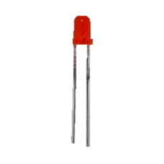
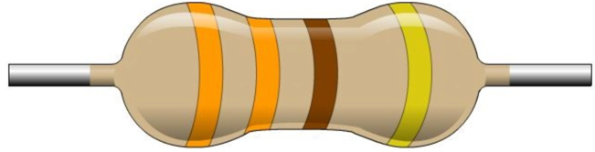
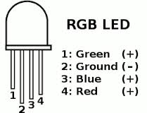
Basic LED Circuits
Blink Lab
The Anode (+) is longer
The Cathode (-) is shorter
Pin 9
Pin 10
Pin 11
GND (-)

